Slide 1
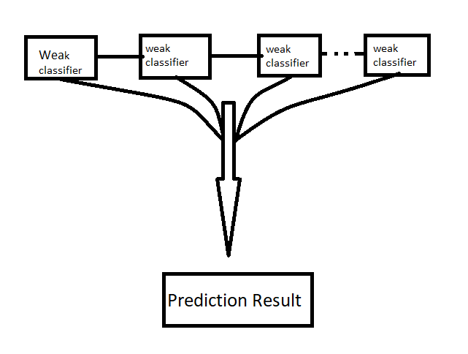
Ada-boost Algorithm
Ensemble method in machine learning
Reassign weight to each instance
Higher weights for incorrectly classified
Reduce bias and variance

Slide 2
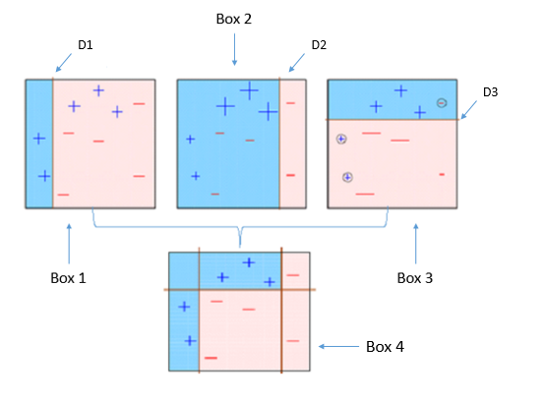
Graphical Representation of Ada-boost:
Weak Learning (Accuracy around 50%)
Decision Tree Stump (Depth =1)
Output range is -1 to +1

Slide 3
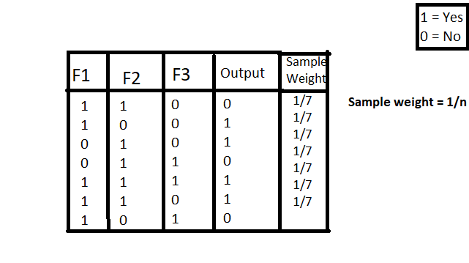
Ada-Boost Calculation:
Step1:

Slide 4
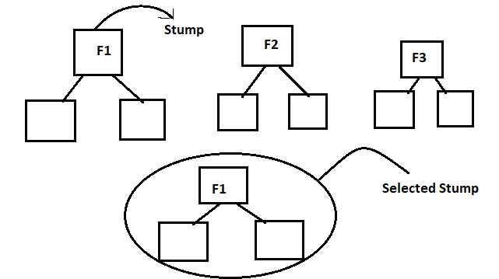
Step-2:
Note : Select the best stump by using Gini Index & Entropy

Slide 5
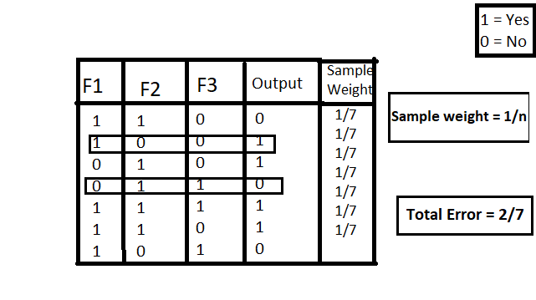
Step-3:

Slide 6
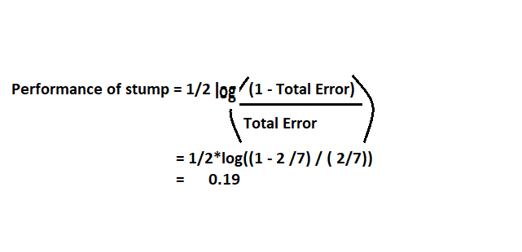
Step-4:

Slide 7
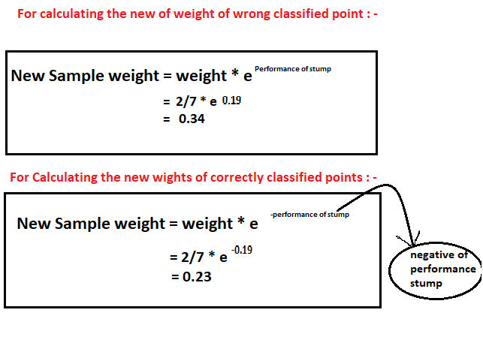
Step-5:

Slide 8
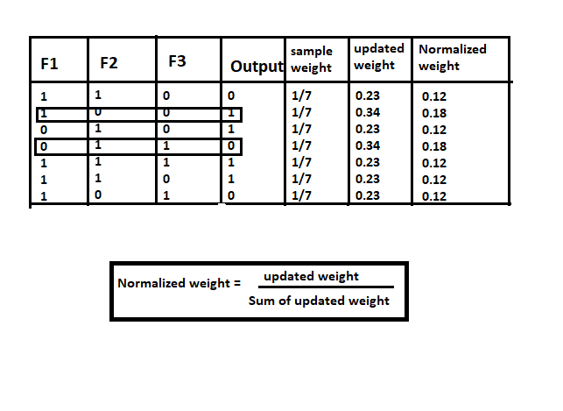
Normalization the Data:

Slide 9
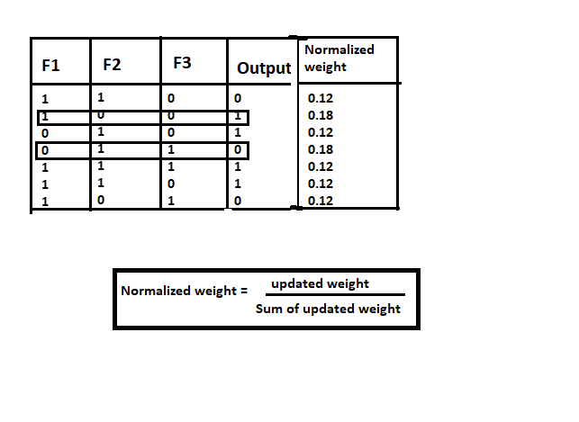
Step-6:
Note: Base on the normalized weight value we will divide the data into some bucket range( 0.12:- 0 to 0.12, 0.18:- 0.12 to 0.19, and so on).

